Slide 1

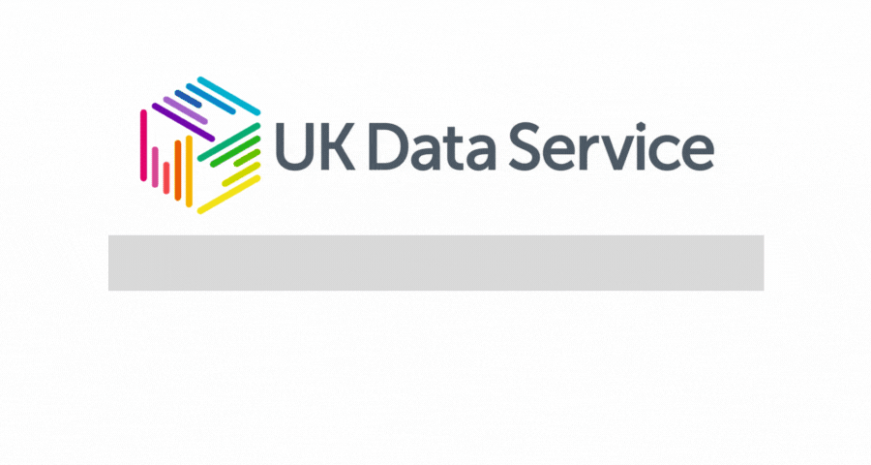

Slide 2

Can you hear us?
Notes:
First of all a quick Poll to hear if everybody can hear us okay?

Slide 3
If you can’t hear us
Check your speaker/headset is plugged in and the volume is on.
Click on audio to change to listening via phone.
We are recording this webinar and will post it on YouTube at www.youtube.com/user/UKDATASERVICE
Notes:
If you can’t please check your speakers and headset are plugged in and your volume is on.
Click on audio and you can listen in via a phone
If none of these work all our webinars are recorded and will be available in the next few days on our YouTube cahnnel.

Slide 4
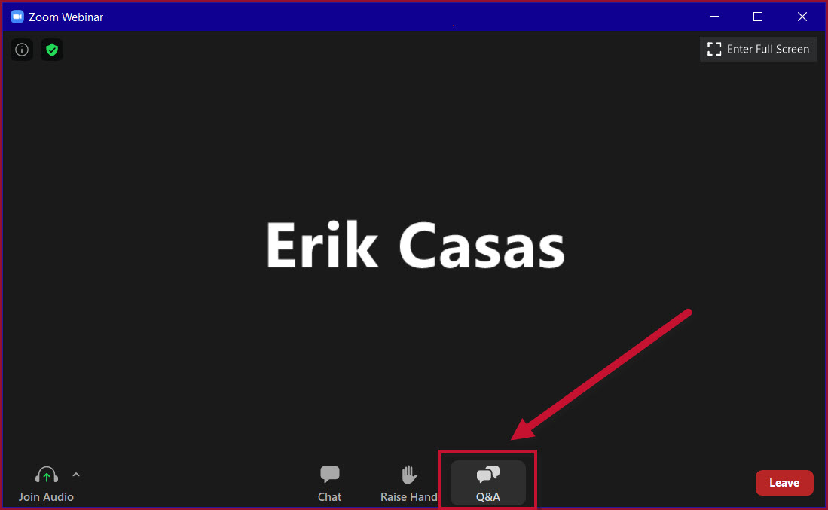
Have questions?
Click the Q&A tab.
Notes:
If you have any questions during or after this webinar, please click the Q&A tab along the bottom menu of Zoom.
Feel free to ask questions during the talk and a facilitator will try to answer swiftly.
Otherwise there will be time for questions at the end, so feel free to ask early and often.

Slide 5
Synthetic Data – Redaction & Masking
Joseph Allen
Research Associate at the University of Manchester
Email: joseph.allen@manchester.ac.uk
Copyright © 2021 UK Data Service. Created by Computational Social Science, University of Manchester
Notes:
Hello everyone and welcome to this UK Data Service Webinar, Synthetic Data – Redaction and Masking.
I am Joseph Allen, a Research Associate with the UKDS in the University of Manchester.
Thank you all for coming

Slide 6

Last time on Synthetic Data
What is Synthetic Data?
Why should we make synthetic data?
Examples, benefits and purposes of synthetic data.
Features of synthetic data.
Notes:
In our last webinar we covered
What synthetic data is
Why should we make synthetic data
What are the benefits and purposes of synthetic data
And finally we covered the features of these different forms of data.
Photo by Stas Knop from Pexels

Slide 7

Poll – Synthetic data use
Have you used Synthetic data before?
Notes:
So before we dig in i’d like to ask if you’ve used synthetic data before!

Slide 8


This time on Synthetic Data
Redaction - removing data entirely.
Masking - replacing data with new, fake data.
Notes:
In this webinar we will be covering two common categories of disclosure control. Disclosure control refers to methods that allow us to protect the confidentiality of subjects of research. These are not synthetic data, but they are often misinterpreted as synthetic data, and solve some similar problems.
If you aren’t familiar with synthetic data you can watch our introduction over on the UK Data Service YouTube channel.
Redaction - this refers to removing data deemed too sensitive. Perhaps removing an entire row or column.
Masking - this refers to replacing parts of the data that are sensitive, for example replacing names with synthetic names, initials or empty strings.
Now you will notice the difference or similarity between these techniques are very vague, and in some methods we could make use of both, for example we could replace names, with an empty string. I see no difference between this and redacting that data, beyond semantics.
We are on the fringe of data technology when we talk about data synthesis and the surrounding area, so things can get a little fluffy.
Photo by Anna Shvets from Pexels

Slide 9
Masking
Replacing data, or parts of data with generated information.
Make up names yourself.
Use a data generation tool like Faker or Mockaroo.
ID | first_name | last_name | email | gender | address
2999 | Grazia | Midden | gmidden@163.com | F | 10 Pawling Center, M3 6GA
Notes:
As we’ve just said Masking is about replacing data, or parts of the data with generated information. Some forms of Masking could be considered a form of data synthesis, but is a larger classification that encompasses both synthetic data, and disclosure control methods.
This masking could be done manually, by generating your own context-inspired data.
Alternatively you could use a data generation tool like Mockaroo, which is a web-based data generation tool.
Or if you are more technical you could search for a data generation library, for example Faker for Python can generate connected data such as names, emails and more.
In this example dataset we could mask every aspect of this data.

Slide 10
Masking Example
Replace Grazia and Midden with a generated name.
We have masked first_name & last_name.
Notice email still holds real data on Grazia Midden.
ID | first_name | last_name | email | gender | address
2999 | Joe | Allen | gmidden@163.com | F | 10 Pawling Center, M3 6GA
Notes:
We could mask the name Grazia Midden, with my name Joseph Allen.
Although we have masked this data there are still multiple ways this individual could be identified. Their email and address could uniquely identify them for example.
Even in this simple case we can make dangerous mistakes. We will go into more detail with this example shortly.

Slide 11
Simulation vs Masking
Simulation | Masking
Modern algorithms | Curated source of synthetic data
Irreversible | May be reversible
Requires technical investment | Relatively simple
Represents distributions of the real data | Quick sampling for GDPR compliance
Notes:
As I’ve said a few times, generally masking isn’t a method of generating synthetic data. Simulation on the other hand is, so lets break down some of the differences between simulation and masking.
Simulation uses modern algorithms, whereas masking uses a curated source of data
Simulation is usually irreversible, Masking methods may be intentionally reversible
Simulation is difficult, masking in comparison is easy
Simulation can represent the statistical spectrum of data, masking is usually a low-effort sampling exercise.
But let's go into these for more details.

Slide 12

Synthesis
Simulation - applies modern algorithms to generate new data.
Masking - replaces data with synthetic data from a curated source.
Notes:
Again with the ambiguity of disclosure control methods, we have a subtle difference between our just defined masking and what is known as simulation.
The main difference here is that simulation comes from the application of modern algorithms and machine learning, or modern data synthesis packages to generate new data, whereas masking is a simpler find and replace method.
Photo by Pixabay from Pexels

Slide 13
Reversibility
Simulation - Uses noise to generate new, fake data. Not reversible.
Masking - Uses real data. Potentially reversible.
Notes:
Simulation techniques often use some random noise to generate new data, whereas masking will ignore a real data input, and output a new, or sampled result. Some of these techniques may be reversible, for example we could map all names to an uppercase version of themselves, the decryption of this method would be to simply lowercase the new names.

Slide 14

Difficulty
Simulation - Requires a large investment to get right.
Masking - Requires a small technical effort.
Notes:
Simulation is very difficult, depending on your dataset, simulating new data may takes weeks to years to generate reliably and to fully understand the context in which that data is used. While it may be more accurate and interesting, this is usually too much investment.
Instead masking can be done relatively quickly with a few lines of code, or it can even be done with something like Excel.
Photo by Andres Ayrton from Pexels

Slide 15

Statistics
Simulation - Maintains statistical distributions.
Masking - Random, but realistic values.
Notes:
Simulation may learn the nuances and statistical distributions of the real data, for example if we had a list of genders and heights, we might notice generally the Males are taller and our generated data would also reflect this.
Masking on the other hand would simply pull from a list of random, but realistic numbers of our choosing. This is a quick solution for potential GDPR compliance.
Photo by Lukas from Pexels

Slide 16
Best practices
Explore your data fully.
Understand the context of data before synthesis.
Use irreversible methods when possible.
Persist the structure of data.
Notes:
Some general best practice advice.
Explore your data thoroughly before claiming you have discovered all special category data. It is possible something will be missed so document what you can and cover your exploration, disclosure control and synthesis in detail.
Understand your data before choosing any masking techniques, this will ensure confidentiality.
Where possible use irreversible methods. It may be that you need to use a tool to encrypt and decrypt data at a later stage, but this opens the door for malicious use so beware.
Try to persist the structure of your data, keep the columns, order of columns, and types of data held within similar.
https://research.aimultiple.com/data-masking/

Slide 17
GDPR Compliance
Article 6 (4-e): “the existence of appropriate safeguards, which may include encryption or pseudonymization.”
Notes:
Businesses are encouraged that encryption and pseudonymization are both valid safeguards within GDPR.
This refers to the process of mapping data to new nonsense synthetic data, with a reversible key. I would suggest you go a step further and make this process irreversible unless you have good reasoning to do so otherwise.
Remember that you may not only be beholden to GDPR depending on the data you are using, and that using encryption or pseudonymization does not guarantee you compliance.

Slide 18

Warning
You likely do not have the right to distribute data.
Ask your data provider.
Notes:
It's important to be aware of the legal implications of synthetic data too. Depending on the data you make use of you may not have the right to distribute that data, synthetic or not.
Consider whether you can legally share any data you have created, and the impact of that data.
If in doubt, communicate with your data provider about the data you've created, the responsibility may fall on them to verify, and distribute your methods.
Photo by Mwabonje from Pexels

Slide 19

2020 Census Manchester
Notes:
Next we will work through a quick case study,
We have access to a fake 2020 census and our goal is to explore and analyse the the people of Manchester, UK.
Photo by Mylo Kaye from Pexels

Slide 20
Case Study – the data
ID | first_name | last_name | email | gender | address
2999 | Grazia | Midden | gmidden@163.com | F | Apt 38 Sillivan Way Manchester M36GD
3000 | Andy | DuFrens | adufrens@123.com | M | 66 Myrtle Road London N13 5QX
Notes:
Although this is based on a fake 2020 census, luckily we only managed to collect two records. It’s feasible that we can generate new synthetic data for our use-case by hand, over writing some complicated code.
We have an ID - 2999
A first_name - Grazia
A last_name - Midden
An email - gmidden@163.com, a combination of the firstname and last name.
A Gender - denoted with an F, perhaps implying a M for Male? Maybe an O for Other?
We also have
We have an ID - 3000
A first_name - Andy
A last_name - Dufrens
An email - adufrens@123.com
A Gender - ah, M for Male perhaps? So part of our assumption before is found to be true.
Let’s assume we need to protect the identity of both these individuals as well as apply some pre-processing. We want to explore the question “What kind of people live in Manchester?”, though we won’t have a deep answer here we can give it a try.

Slide 21
Case Study - ID
ID | first_name | last_name | email | gender | address
2999 | Grazia | Midden | gmidden@163.com | F | Apt 38 Sillivan Way Manchester M36GD
3000 | Andy | DuFrens | adufrens@123.com | M | 66 Myrtle Road London N13 5QX
Notes:
So to start with let's look at this ID. does the ID 2999 imply there are 2998 missing rows? Could this ID be used internally within the organisation? Paired with another dataset could this identify an individual?
Our second record has an ID of 3000, this seems to imply that these IDs are incremented with each new record.
Without domain knowledge it’s really difficult to know how dangerous this ID column could be. There may be restrictions on this data that cause an API to fail down-the-line, so we need to be careful with any assumptions we make.

Slide 22
Reindexed ID
ID | first_name | last_name | email | gender | address
9000 | Grazia | Midden | gmidden@163.com | F | Apt 38 Sillivan Way Manchester M36GD
9001 | Andy | DuFrens | adufrens@123.com | M | 66 Myrtle Road London N13 5QX
Notes:
For now let’s generate two new, sequential 4 digit numbers, we also need to note that we have done this in our documentation.
We are now masking our values 2999 and 3000, with 9000 and 9001.

Slide 23
Case Study - Names
ID | first_name | last_name | email | gender | address
9000 | Grazia | Midden | gmidden@163.com | F | Apt 38 Sillivan Way Manchester M36GD
9001 | Andy | DuFrens | adufrens@123.com | M | 66 Myrtle Road London N13 5QX
Notes:
Now we get onto “freetext” fields, which are often not useful in an analysis piece. With some preprocessing we could make some huge assumptions from this about race, age, but it’s best to seek an alternative source of data for this. We could remove these altogether, but for now let’s try to maintain the shape of our original data.
The name Grazia Midden might not be unique to this individual, but she may be the only Grazia Midden in the UK, and even more likely the only Grazia Midden in Manchester. It is for this reason that these need to be removed as we reduce the scope of our data.
We should generate a new first and last name through a masking method such as pulling a random name from a curated source.

Slide 24
New Names
ID | first_name | last_name | email | gender | address
9000 | Georgina | Shicky | gmidden@163.com | F | Apt 38 Sillivan Way Manchester M36GD
9001 | Joseph | Allen | adufrens@123.com | M | 66 Myrtle Road London N13 5QX
Notes:
I’ve replaced Grazia Midden with Georgina Shicky and Andy Dufrens with Joseph Allen. We could have made use of a data generation library like Faker, or Mockaroo here. Instead i’ve used the curated source of my head to imagine some new names.

Slide 25
Case Study - Email
ID | first_name | last_name | email | gender | address
9000 | Georgina | Shicky | gmidden@163.com | F | Apt 38 Sillivan Way Manchester M36GD
9001 | Joseph | Allen | adufrens@123.com | M | 66 Myrtle Road London N13 5QX
Notes:
As a test we should move along this record and find the next attribute which no longer makes sense.
It seems odd to me that Georgina Shickys email contains midden, perhaps a previous last name. It’s not impossible that this could change but it is something we could quickly synthesize while we are here.
Further to this emails are unique identifiers under GDPR, this is something that we will need to change as gmidden@163.com is still Grazias original email. We need to replace both of these emails, while maintaining their connection to the name columns.

Slide 26
Connected Email
ID | first_name | last_name | email | gender | address
9000 | Georgina | Shicky | gshicky@123.com | F | Apt 38 Sillivan Way Manchester M36GD
9001 | Joseph | Allen | jallen@678.com | M | 66 Myrtle Road London N13 5QX
Notes:
Generating a random email wouldn’t work here, we would still have no connection between our name and email data. Instead we need to generate an email, related to our names. Mature data generation tooling will handle this for us thankfully.
We could argue that this is the first part of this process that involves synthetic data, we have a “model” which happens to output the first letter of the first name, append the lowercase sir name to it, and generate a random 3 digit email provider. Until this point everything has been masking with some logic.
While not entirely realistically we have matched the format of the emails we have seen so far.

Slide 27
Case Study - Gender
ID | first_name | last_name | email | gender | address
9000 | Georgina | Shicky | gshicky@123.com | F | Apt 38 Sillivan Way Manchester M36GD
9001 | Joseph | Allen | jallen@678.com | M | 66 Myrtle Road London N13 5QX
Notes:
Next we look at the gender column.
We have assumed F refers to Female, and M refers to Male. This assumption may be false depending on organisation logic, hopefully there is documentation we can check. Luckily in this case our genders seem to correspond with the first names provided. There may also be options beyond only Male and Female
It is possible that after our synthesis of a new name it may contradict with this gender. In our email column we realised that emails have something in common with the first and last name columns. A gender may be connected to the first name column.
If we make use of a data mocking tool or library we can generate a coherent individual, making sure all these fields are consistent.
Depending on our research question we may not care about gender, names or emails at all. With some redaction or pre-processing we could elicit some more useful information out of these fields.

Slide 28
Case Study - Address
ID | first_name | last_name | email | gender | address
9000 | Georgina | Shicky | gshicky@123.com | F | Apt 38 Sillivan Way Manchester M36GD
9001 | Joseph | Allen | jallen@678.com | M | 66 Myrtle Road London N13 5QX
Notes:
Finally, we look at our address column.
This again is GDPR, protected information, we shouldn’t be able to find this individual, despite not knowing their name. Removing the house or apartment number could be sufficient. We will cover techniques around reducing precision in the next webinar.
For the sake of this project, we want to analyse the people of Manchester, so perhaps reducing to the city or a top-level postcode of this resident alone is good enough.
Lets generate a new, and synthetic address for each user, preserving the city they live in.

Slide 29
Synthetic Address
ID | first_name | last_name | email | gender | address
9000 | Georgina | Shicky | gshicky@123.com | F | Apt 66 Filey Road Manchester M3 6A
9001 | Joseph | Allen | jallen@678.com | M | 66 Chancery lane London N13 5QX
Notes:
So now at this point we have two entirely non-identifiable records. There may be real people named Georgina Shicky, and Joseph Allen. But this entire individual, with their email, genders and addresses were generated using random data, it’s statistically unlikely that they exist and if they did it would be a coincidence. We’ve documented out steps so this method can be verified by others. And depending on our data provider this could be data we could share alongside our research, we go a long way making our research reproducible through these methods.
But perhaps there is more we can do? Remember our research question, for now, is only focused on Manchester. There are some aspects of this data we don’t need.

Slide 30
Case Study - Redaction
ID | first_name | last_name | email | gender | address
9000 | Georgina | Shicky | gshicky@123.com | F | Apt 66 Filey Road Manchester M3 6A
9001 | Joseph | Allen | jallen@678.com | M | 66 Chancery lane London N13 5QX
Notes:
Really, we don’t need any data on users outside of Manchester, so we can filter all non-manchester users out by their postcode or city.
Also, while the freetext data is useful to create an indistinguishable dataset, we don’t gain anything at this point from knowing emails and names.

Slide 31
Case Study - Synthesis Process
Generate a new index
Generate a first_name and last_name
Generate a realistic email & gender
Generate a new address
ID | first_name | last_name | email | gender | address
9000 | Georgina | Shicky | gshicky@123.com | F | Apt 66 Filey Road Manchester M3 6A
9001 | Joseph | Allen | jallen@678.com | M | 66 Chancery lane London N13 5QX
Notes:
So to summarize that process.
We generate a new ID of 9000, this could increment but our assumption is that it has to be four digits .
We have generated a new first and last name using our minds, though we could use a curated internal file, or a data generation library.
We have made use of these generated first and last names to generate a realistic email address.
We created a realistic gender, I recommend using a data generation library to do this but be aware of the implications of doing so.
Finally we generate a realistic address for this user, restricted to the same top-level postcode.

Slide 32
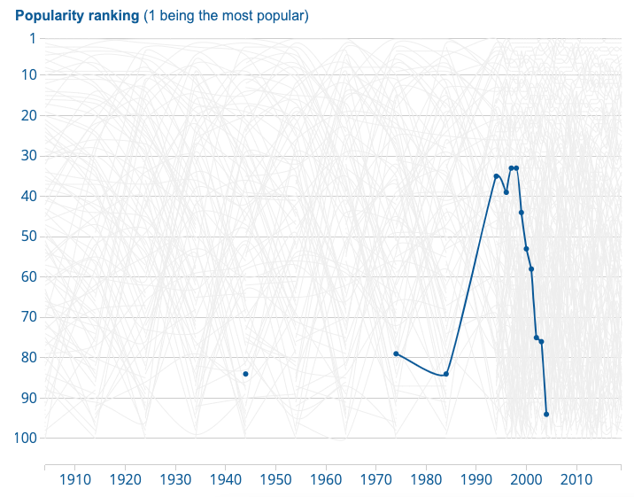
What’s in a name?
Ranking of the name “Georgina” over time
Notes:
We could perhaps imply that a first_name implies an age range, ethnicity etc.
Just having knowledge on a user having an email could elicit information about their age, or access to technology.
These are bold assumptions to make and many analysts would refuse to do so, make it clear if you do anything like this, and personally my goal with this work would be to showcase those assumptions and use that to get access to more reliable data.
Using historic data we could imply the name Georgina has italian heritage, it might however just be a nice name.
Using the ONS baby name explorer we can see the rise in popularity of names for different babies, we can see the name Georgina peaks in use around 20-30 years ago. Again another assumption.
ONS baby name explorer - https://www.ons.gov.uk/peoplepopulationandcommunity/birthsdeathsandmarriages/livebirths/articles/babynamesexplorer/2019-06-07

Slide 33
Name - Assumptions
ID | ethnicity | Age | hasEmail | gender | address
9000 | Italian | 20-30 | True | F | Apt 66 Filey Road Manchester M3 6A
Notes:
We could showcase these assumptions and use our findings to try to elicit more reliable data. However, the more we assume, the less precise our results, and the less in good faith policy changes informed by this research would be, so let's stick to what we know.

Slide 34
Case Study - Final data
ID | gender | address
9000 | F | M3
Notes:
So finally we have the following. We created a synthetic, non-identifiable record which represents and in this case entirely matches the distribution we saw in the real data.
We have an ID, which won’t serve any purpose in our research.
A gender, we could claim that 100% of the people in Manchester are Female, though we know this is a limitation of our poorly collected census over anything else.
I have coarsened the address to only the top-level postcode, to make sure we only collect Manchester individuals, and plot a population distribution.

Slide 35
Case Study - Documentation
We’ve been forced to make a lot of assumptions:
F is female.
M is male.
IDs must have 4 digits .
No rows are missing.
ID, gender and a coarsened address are sufficient.
Notes:
We’ve been forced to make a lot of assumptions about this data because of the lack of documentation. To name a few,
That F means Female, and M means Male
IDs must have 4 digits, and no rows are missing, only 2 in our entire census
That only the ID, gender and a coarsened address are needed for our study.
The responsibility is on the person generating the synthetic data to document and share these assumptions. Without the context of the original data it can be very difficult to ethically generate more.

Slide 36
Case Study - Redaction Process
Redacted rows not in Manchester.
Redacted free text columns - first name, last name and email.
Redacted all address data beyond the city and top level postcode.
ID | gender | address
9000 | F | M3
Notes:
To summarize the process of redaction
We redacted all rows not containing Manchester data, irrelevant to our research
We redacted the freetext columns, first name, last name and email. While we could imply countless other things we can’t justify keeping them for now.
Finally we redacted parts of the address data, leaving only the top-level of the postcode.

Slide 37

Disclosure Control - Masking
Notes:
Okay that was a whirlwind!
So now we have seen the general process that goes behind preparing a dataset for use. Let’s discuss what masking is in more detail, and the advantages and disadvantages behind a variety of methods!

Slide 38
Masking Techniques 1
Substitution - Replacing data with data from a source.
Shuffling - Changing the order of data.
Variance - Adding small amounts of noise to data.
Encryption - Traditional encryption using a key.
Notes:
Some of the masking methods are summarised as follows:
Substitution - this involves replacing data with data from a curated source, this might be a simple text file of names, randomly generated numbers or even the use of a sophisticated data generation library.
Shuffling - this involves randomly changing the order values appear in columns, using real user data, but mixing it up.
Variance - adding or removing small amounts of noise to numeric values
Encryption - using any encryption technique to translate data into nonsense values, with the decryption key we can return to original values.

Slide 39
Masking Techniques 2
Scrambling - Changing the order of characters in data.
Nulling out - replacing data with null values.
Masking out - replacing parts of the data with a clear fake value.
Notes:
Scrambling - rearranging the order of characters, using real data.
Nulling out - replacing data with clear null values
Masking out - replacing data with clear fake values such as “FIRST NAME” or “XXXX”

Slide 40
Sharing Data
Method | Suitable for unauthorized users?
Substitution | Maybe
Shuffling | No
Variance | No
Encryption | Maybe
Scrambling | No
Nulling out | Maybe
Masking out | Maybe
Notes:
Of these techniques I would say that Encryption, Nulling out, Masking out and Substitution are the only values which might ever be appropriate to share. Again this depends heavily on your data provider.
But let’s go into more detail on each of these techniques.

Slide 41
Substitution
Method | Anonymous | Indistinguishable | Technical | Practical
Substitution | Maybe | Maybe | Yes | Yes
Name | Age
Grazia Midden | 24
Andy Otto | 45
Name | Age
Andy Dufrens | 24
Joseph Allen | 45
Notes:
So to start we have substitution. Personally I believe this to be the best form of masking you can do, when done right there should be no personal data, your data should be indistinguishable from real data. While it is a technical process I think you get the most value for your time with this.
You could do this in Excel, but personally I would go for a programming approach to generate the data we need using a Data generation library.
The source of these substitutions could be a curated spreadsheet of fake data, randomly generate values, or connected values using a data generation tool like Mockaroo or Faker.
In this example table we have two users
Grazia Midden - age 24 and Andy Otto - age 45
In substitution we use a curated source with realistic names and connected data, for simplicity's sake let’s ignore any correlation between names and ages. We substitute in the new names Andy Dufrens and Joseph Allen. Yes the ages are still there, but realistically these ages blend in with thousands of similar individuals. Used in combination with a variance based method to adjust numerical values we have a good solution to data masking here.

Slide 42
Shuffling
Method | Anonymous | Indistinguishable | Technical | Practical
Shuffling | No | No | Yes | No
Name | Age
Grazia Midden | 24
Andy Otto | 45
Name | Age
Andy Otto | 24
Grazia Midden | 45
Notes:
Shuffling refers to changing the order of values in columns. Because we use real data here we aren’t protecting individuals as much as we should. Under GDPR a real name, alone, is still a personal identifier even though the remaining data is not connected.
Depending on your shuffling technique, some rows may contain the same data they started with, this can be avoided but it it requires more technical work.
Personally I believe if you’re capable of doing this, you should using the substitution method instead.
In our example all this means is we swap our two names around, so while there is no real individual called Grazia Midden, age 45 we are still showing that we have a Grazia Midden’s data.

Slide 43
Variance
Method | Anonymous | Indistinguishable | Technical | Practical
Variance | No | Yes | Yes | Yes
Name | Age
Grazia Midden | 24
Andy Otto | 45
Name | Age
Grazia Midden | 26
Andy Otto | 44
Notes:
Variance based methods involve adding or removing a random value to numeric data. We lose some precision here which can potentially have knock on effects if we plan to use machine learning in this project. Our general trends may appear to remain the same. We have a trade-off between confidentiality and analysis that will always be context-dependent.
While we could apply this to any numeric or ordinal data, it makes less sense with freetext and categorical columns which often contain more dangerous personal data.
In this example we simply add a number from -2 to +2 to each age. While we still know the names, and could still make true statements like “Grazia is younger than Andy” we aren’t protecting much here. Used in combination with Substitution to resolve privacy concerns this is a practical masking method.

Slide 44
Encryption
Method | Anonymous | Indistinguishable | Technical | Practical
Encryption | Maybe | No | Yes | Yes
Name | Age
Grazia Midden | 24
Andy Otto | 45
Name | Age
Rw10”£ | 24
S)!”SS | 45
Notes:
In encryption methods we can use any modern encryption algorithm to convert our data into an unreadable form. This will normally turn our data into some unreadable nonsense, meaning we can distinguish something isn’t valid here. As this real data ideally can only be cracked using our decryption method we should be safe to share it externally. We do have to ask though, what is the point of doing this? Why use encrypted data when a substitution could be reasonable, and have more benefits?
One benefit is that for compliance sake, if we do get a request to destroy this data, simply deleting the single decryption key, rather than tracking down files could be enough to ensure this data becomes valueless. In some aspects having a reversible method is a benefit as well.
In this example we are applying some encryption to our names, they don’t look like names anymore and I would worry that names containing these special characters might break some processing we do on these names internally.

Slide 45
Scrambling
Randomly rearranging the characters in a string.
Method | Anonymous | Indistinguishable | Technical | Practical
Scrambling | No | No | Yes | No
Name | Age
Grazia Midden | 24
Andy Otto | 45
Name | Age
zaairG dMinde | 24
dyAn tOto | 45
Notes:
Scrambling involves randomly rearranging the characters in a string. Similar to Shuffling there are cases here where data could be almost identical post-scramble. If Joseph became Josehp you’d probably be able to crack this scramble.
Also there are countless anagram solvers that could make short work of this.
Since it’s potentially reversible, the data doesn’t look real, and this requires technical skills I would strongly suggest something using substitution instead.
In our example below we can see that while the names are scramble, capital letters, and space characters could give us extra clues to the original format of the name. Putting ZaariG into and anagram solver gave me 10 results and one was the correct name. Not great. Again i’d recommend substitution over this.

Slide 46
Nulling out
Replace data with null values.
Similar to redaction, but shows we intentionally removed the data.
Name | Age
Grazia Midden | 24
Andy Otto | 45
Name | Age
NULL | 24
NULL | 45
Notes:
Nulling out refers to replacing entire pieces of data with a clear NULL value, showing that this data exists in a full dataset, but has been intentionally removed for this purpose. A benefit here is that an analyst could speculate on what these columns could add and use this as the foundation of a research question. We could see this as a slight benefit over full redaction of a column.
This can be done in Excel, but may require something more powerful if the dataset is large enough.
Again in our toy example you can see i’ve replaced the names with a large and obvious NULL value, if I had documentation I would make it clear these have been removed.
A potential problem with this method is that we are signalling with these Null values, assuming there aren’t actually null values in a dataset. Those of you that have dived into any large dataset will know there are frequently mistakes, missing data and more. Our null values might not stand out as proudly as we expect, this is why I prefer the masking out method.

Slide 47
Masking out
Replace some of the data with fake data.
Commonly used to show your credit card number as
XXXX XXXX XXXX 1234
Name | Age
Grazia Midden | 24
Andy Otto | 45
Name | Age
NAME | 24
NAME | 45
Notes:
Masking out refers to replacing parts of the data with obviously fake data.
This could be replacing every bit of data with a nonsense string, but often we use some clear fake data allowing us to showcase that this data is not null intentionally. For example we may simply use the data attribute like AGE, NAME, GENDER to show what was there. It’s also important we document that we have done this!
A relatable example of this might be when your card details are shown in bank statements or online purchases. Often the car number is shown as three groups of 4 X’s, mimicking the structure of a card number, but still revealing the last 4 digits. This is safe enough to display without risking your bank account.
In our example dataset we might simply replace our Names, with the large word NAME, and document that we have done this. I prefer this option to flat out redaction or nulling out as we retain some context.

Slide 48
Masking Comparison
Method | Anonymous | Indistinguishable | Technical | Practical
Substitution | Maybe | Maybe | Yes | Yes
Shuffling | No | No | Yes | No
Variance | No | Yes | Yes | Yes
Encryption | Maybe | No | Yes | Yes
Scrambling | No | No | Yes | No
Nulling out | Maybe | No | Maybe | Yes
Masking out | Maybe | No | Maybe | Yes
Notes:
So here we recap all of these methods. I won’t go through them all again but I reiterate if you are going to go to the the extent of trying to provide confidentiality, avoid the methods that don’t give you un-identifiable records. Try to keep context where you can and use methods which generate indistinguishable data.
If you are proficient in Excel or a programming language,
My recommendation for a dataset would be to apply substitution or Masking out to all protected fields, or fields connected to protected fields. Add in a light amount of variance to any numeric data, and perhaps to ordinal data if you have it carefully. Keep this amount small as it will affect any analysis performed.
If you aren’t too confident here I'd suggest simply Nulling out protected and special category data.
I strongly suggest you avoid scrambling, or shuffling.
Encryption can be a fantastic option for GDPR compliance, but be aware if you are beholden to any other legally binding data providers!
Whatever process you do choose please document your methods to protect yourself. And always check with your data provider whether you are allowed to do this work with your data, they may be grateful, but they may also be concerned you are breaking the terms agreed to.

Slide 49
Disclosure Control - Redaction
Notes:
So we are done with Masking!
Next we move onto Redaction

Slide 50
Redaction
Notes:
We may be familiar with the media presented redaction, where documents are manually scraped and restricted information is painted over with a black pen. Often here entire sentences are redacted and the general context of a document is lost.
Image source
https://towardsdatascience.com/revolutionising-redaction-my-final-year-project-fe664e28ef84

Slide 51
What is Redaction?
Redaction - Removing sensitive data from our dataset
Sensitive - military bases and hospitals in a dataset.
Outliers - sometimes being an outlier is enough to identify individuals.
Notes:
When we talk about redaction as a method of disclosure control we refer generally to any process where we remove data from our dataset. This could be removing sensitive records or a set of columns.
We might want to remove particular rows from our dataset as they may be particularly dangerous, for example we may not want to present the locations of our military bases and hospitals in a dataset of an active warzone.
We also might need to redact a record as the nature of an outlier might be so extreme, that the outlier itself becomes a personal identifier and is therefore protected under GDPR.

Slide 52
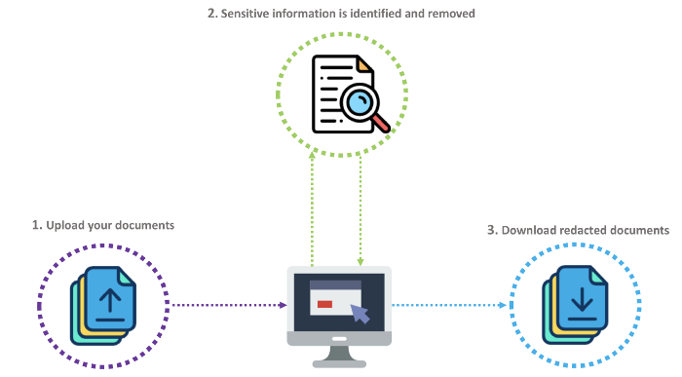
Automated Redaction
Notes:
There are now online tools and published methods to automate the redaction process.
These involve uploading our documents, running a model trained on the specific language of that document, and returning the redacted document.
We could replace the redactions with a relevant term so the context is not entirely lost.
We can also review these redacted documents to see if our model needs extra training, or there are any edge cases we have missed.
Image source
https://towardsdatascience.com/revolutionising-redaction-my-final-year-project-fe664e28ef84

Slide 53
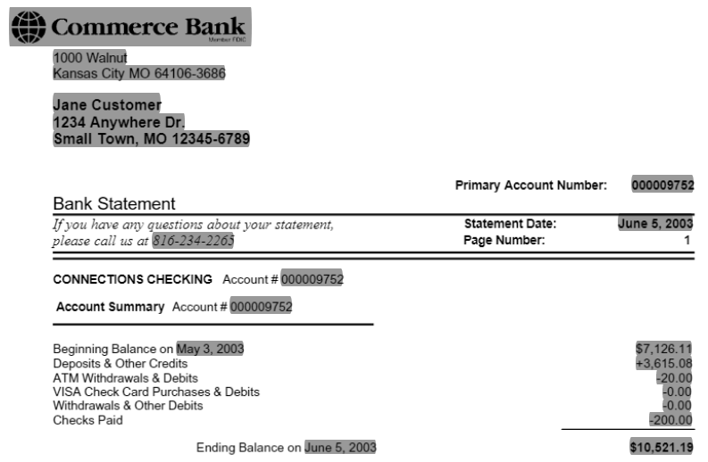
Redacted Bank Statement
Notes:
Here we have an example output from such an online tool. We can see the bank name, logo, customer details, dates and amounts have all been redacted. Though the privacy here would be well protected, what is the point of holding a document with almost no information?
As we discussed in the last webinar what we choose to redact is heavily context dependent.
For example the question “How did personal savings change over 2020?” Might warrant us storing the end balance of this account, but we definitely don’t need the customers name or address.
Image source https://redacted.ai/document/-MRyyoa6DJigflD5_rqy

Slide 54

Poll - Number of Sisters
How many sisters do you have?
You should see a poll on your screen
Notes:
So before we get into a redaction example, I want to ask you all how many sisters you have! We won’t be holding this data or anything like that, this is an optional survey if you don’t wish to answer.
REFLECT ON RESULTS.
Call out unique results, If only one attendee has 3 sisters, you know who you are and you might feel personally identified right now!
Min
max
Photo by rahajengmrlt from Pexels

Slide 55
Sisters Dataset
Student ID | Average grade | Number of sisters
1 | B | 1
2 | A | 2
3 | A | 11
4 | B | 1
Notes:
As an example, let’s say we have a table of data on four students in a class together.
Our first student has an average B grade, and 1 sister.
Our second has an average A grade and 2 sisters. Our 3rd has an average A grade and 11 sisters.
Our fourth has an average B grade and 1 sister.
Which of these students could potentially be uniquely identified, even with this limited dataset?
ADD Poll Number of sisters

Slide 56
Student 3
Knowing which student has 11 sisters might reveal the identity and grade of this record.
Student ID | Average grade | Number of sisters
1 | B | 1
2 | A | 2
3 | A | 11
4 | B | 1
Notes:
If your answer was student 3, you’re correct!
In fact, if this is a UK based student there are only a handful of children this could be. We are close to the record number of sisters.
The point here is that having a high number of sisters could be enough to identify an individual in a particular school with confidence.

Slide 57
Student 2
What about Student 2?
Student 2 could be uniquely identified as the only student with 2 sisters.
Student ID | Average grade | Number of sisters
1 | B | 1
2 | A | 2
3 | A | 11
4 | B | 1
Notes:
But what about student 2? They only have 2 sisters. If we knew more about this dataset, for example which school and which class we were looking at we could as easily identify student 3 as we could student 2.
If the class was larger it’s more likely that 2 sisters would be less significant and this student could blend in with the crowd. This is not the case for student 3.

Slide 58
Protected students
Students 1 and 4 cannot be uniquely identified.
Student ID | Average grade | Number of sisters
1 | B | 1
2 | A | 2
3 | A | 11
4 | B | 1
Notes:
And in the same logic, student 1 and student 4 are somewhat protected, being that they share the same average grade and same number of sisters.
Students 1 and 4 cannot be uniquely identified as there are two students with 1 sister, and an average grade B

Slide 59
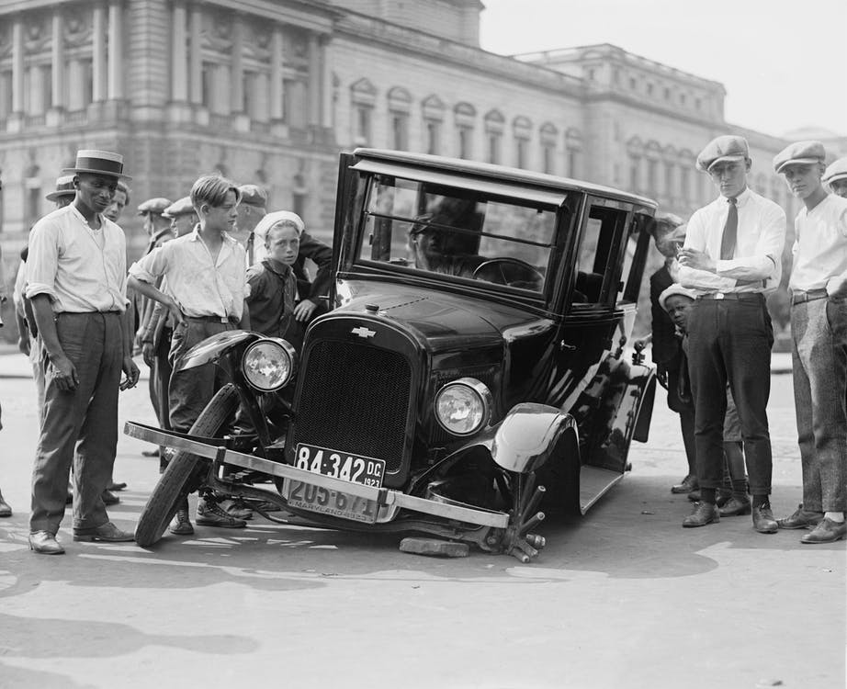
Outliers
Outliers can be the most important
Only with context, can we redact appropriately
Notes:
Context again is incredibly important here. What if our study question was for example “What is the connection between the number of sisters a student has, and their grades obtained?” This outlier with 11 sisters could be the most important data we have for our project. Redacting it might not make sense in this case.
In many cases, machine learning is applied to predict the rarer outcomes. When a medical scan contains a tumour, when a car crashes, when credit card fraud takes place. Redacting on whether or not a row contains outliers might be the worst thing we can do for an analysis. This is where the other synthesis techniques can protect our individuals. It is only when knowing this context can we decide whether or not redaction is appropriate.
Photo by Pixabay from Pexels

Slide 60
Redaction - Row
We remove our obvious outlier, with 11 sisters.
Implied correlation between grades and number of sisters.
Student ID | Average grade | Number of sisters
1 | B | 1
2 | A | 2
4 | B | 1
Notes:
To protect our individual with 11 sisters, we remove them entirely.
Since we don’t have anything telling us which district, school or class we are looking at our dataset could now blend in with the thousands of students in the UK. Now this record could realistically represent any students in any school.
Even in this small dataset there seems to be an implied correlation between grade attainment and the number of sisters a student has.
Our deleted row may be very useful, but we can no longer use it in this analysis.
We could perform our analysis on the full dataset, but only release the redacted dataset for verification and outline the steps to obtain the full dataset to make our results reproducible.

Slide 61
Redaction - Columns
Free Text is rarely useful in Machine Learning.
They can become useful with pre-processing.
ID | Age | Name
1 | 12 | Pattie
2 | 15 | Daren
3 | 13 | Shara
4 | 8 | Andy
Notes:
Depending on the problem we are trying to solve, removing columns might be more appropriate than removing outliers or sensitive rows.
Free text, names, emails and similar may not be useful in their raw forms in a machine learning context.
With some preprocessing a name could elicit an age, gender, religion, race and more. These could be more useful features, and better protect privacy. That being said, assuming any of these protected fields off another must be stated clearly as it is a huge and perpetuating assumption to make, I would suggest using it only to form a basis of research and then using that to obtain further reliable data.
A research question “How is age distributed across Manchester?” warrants us having age and location data, but the names of individuals may be unnecessary. In this case, redacting this column is acceptable.
In this example the names column doesn’t help with our hypothesis. We could remove the column altogether, creating an age dataset with no other details. Alternatively we could process this column.
For example we could assume gender based on these names. Pattie and Shara may be Female, Daren and Andy may be Male.
This is an assumption but now we can add a section in our report on the age distributions of different genders in Manchester, seek out further data and more.

Slide 62
Redaction - Part
In some cases redacting only part of the data may be useful.
Joe Allen -> Joe
42 Wallaby Way -> Wallaby Way
1234 5678 1234 1234 -> XXXX XXXX XXXX 1234
Coarsening, Nulling Out and Redaction all look the same.
Notes:
Redaction can also refer to removing only part of the data, for example we could remove the last name of every name, the house number in any street address, or as previously stated the XXXX’s in our credit card example.
Arguably we could say by doing this we are merely reducing the precision of our data, a definition we will return to in the next part of this series. We could also argue that replacing parts of data with null values is equivalent to the nulling out method of masking.
Again we are seeing that some of these methods are vague enough to not fall into any one category of disclosure control. Again this is a matter of semantics.

Slide 63
Again a Poll?
Have you used Synthetic data before?
Notes:
And again now we’ve covered this i’d love to see if you’ve changed your mind about what synthetic data is?
Reflect on results
I think we could argue for a long time about what is actually considered the creation of new data.

Slide 64
Conclusion
Redaction is a quick-fix to remove protected fields.
Masking provides context, whilst requiring some technical skills.
Use the substitution method with a data generation library for protected fields.
Use variance sparingly on numeric fields.
Notes:
To conclude:
Redaction is a quick-fix to remove protected and personally identifying data
Masking can provide confidentiality, but further to this it can provide some context in the absence of that data. It is slightly more technical
My suggestion is to use the substitution method through a data generation source like Faker or Mockaroo
Use variance on numeric or ordinal fields, but don’t overdo it!

Slide 65


Next time on Synthetic Data
Coarsening - Reducing precision of data
Mimicking - generate a dataset that closely matches the real dataset but does not contain exactly the same entries
Simulation - Generating new data from observed patterns.
Notes:
Join us next week where we cover Coarsening and Mimicking, two more methods of disclosure control
And finally we will look at simulation, a real application of data synthesis.
Photo by Mason Slover from Pexels
Photo by Alex Knight from Pexels

Slide 66
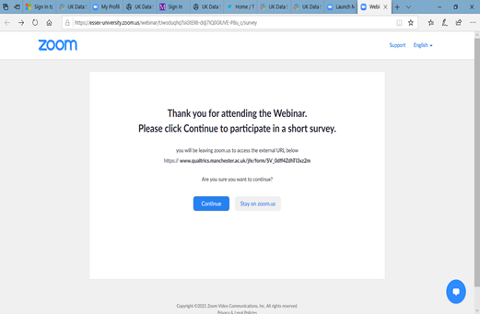
Evaluation
When you leave the webinar, please complete our short Qualtrics survey.
Click on ‘continue’ to access the survey.
Notes:
After this webinar ends you should see a prompt to leave some feedback, please go through this short survey as it helps us make better webinars for you!

Slide 67
Further Reading
Data in Government Blog tinyurl.com/Synth-DataInGov
What is Data Masking? research.aimultiple.com/data-masking
Revolutionising Redaction towardsdatascience.com/revolutionising-redaction-my-final-year-project-fe664e28ef84
Notes:
If what you just heard interests you here are some further readings
The data in government blog categorises and explains some different methods of data synthesis.
We have a great blog post which covers the differences between masking and simulation.
And a blog post covering a students masters project in automating redaction
But otherwise see you in the next webinar, and we will be taking questions now.

Slide 68
Questions
Contact me on Twitter twitter.com/JosephAllen1234
Contact the UK Data Service ukdataservice.ac.uk/about-us/contact
Joseph Allen
Joseph.allen@manchester.ac.uk
Notes:
Thanks everyone and please feel free to start asking any questions now, I will have a look through the Q&A tab shortly.
If you have any thoughts that come after this talk, or you’re watching the recording on YouTube feel free to message me on my Twitter or email me at joseph.allen@manchester.ac.uk.

